Slide 1

Tennessee Tech ECE 1000 Final Project Robot Arm
ECE 1000: Explorations in ECE
Electrical and Computer Engineering
Tennessee Tech University
April 25, 2024

Slide 2
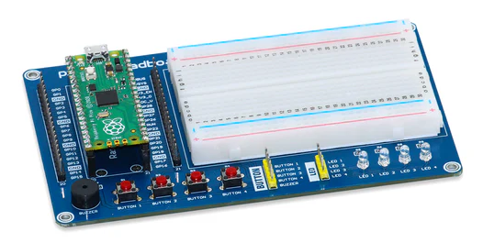
Look at the Microcontroller
Used Raspberry Pi Pico Microcontroller
Programmed using Python
It tells the servos what to do

Slide 3
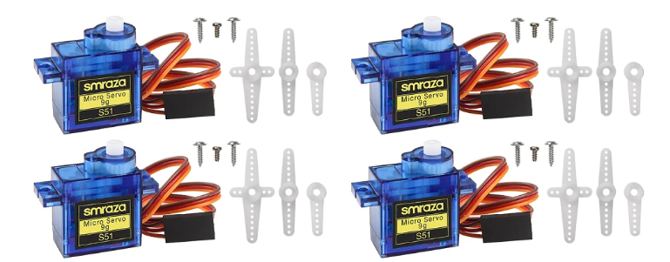
Look at the servos
Controlled three 9g Micro servos
They are what makes
everything move

Slide 4
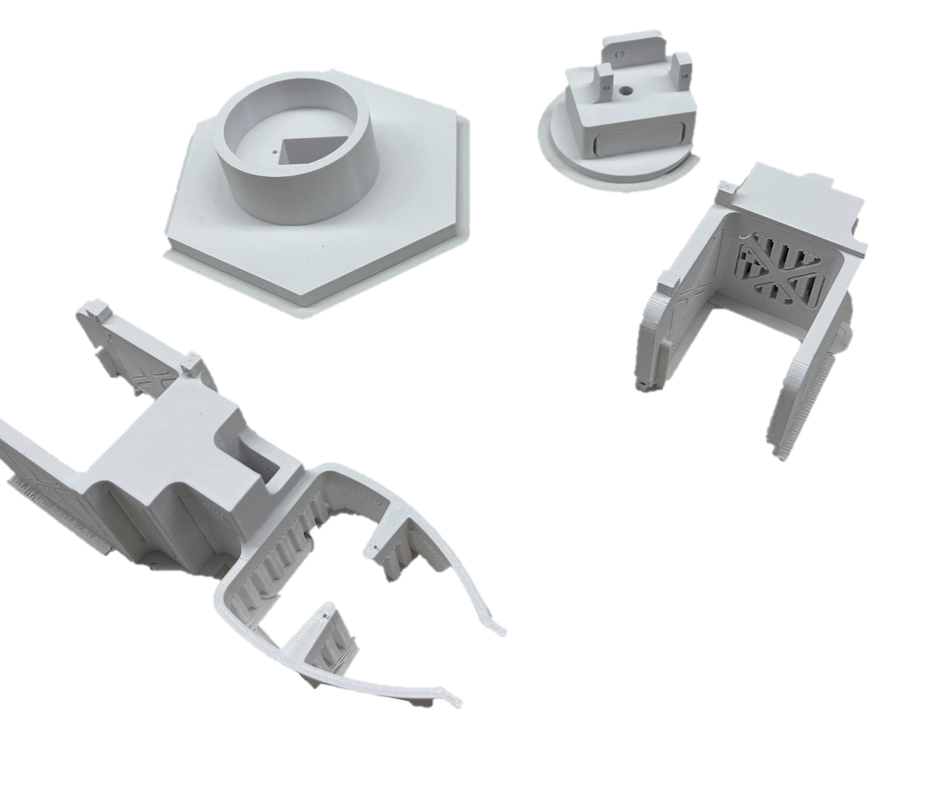
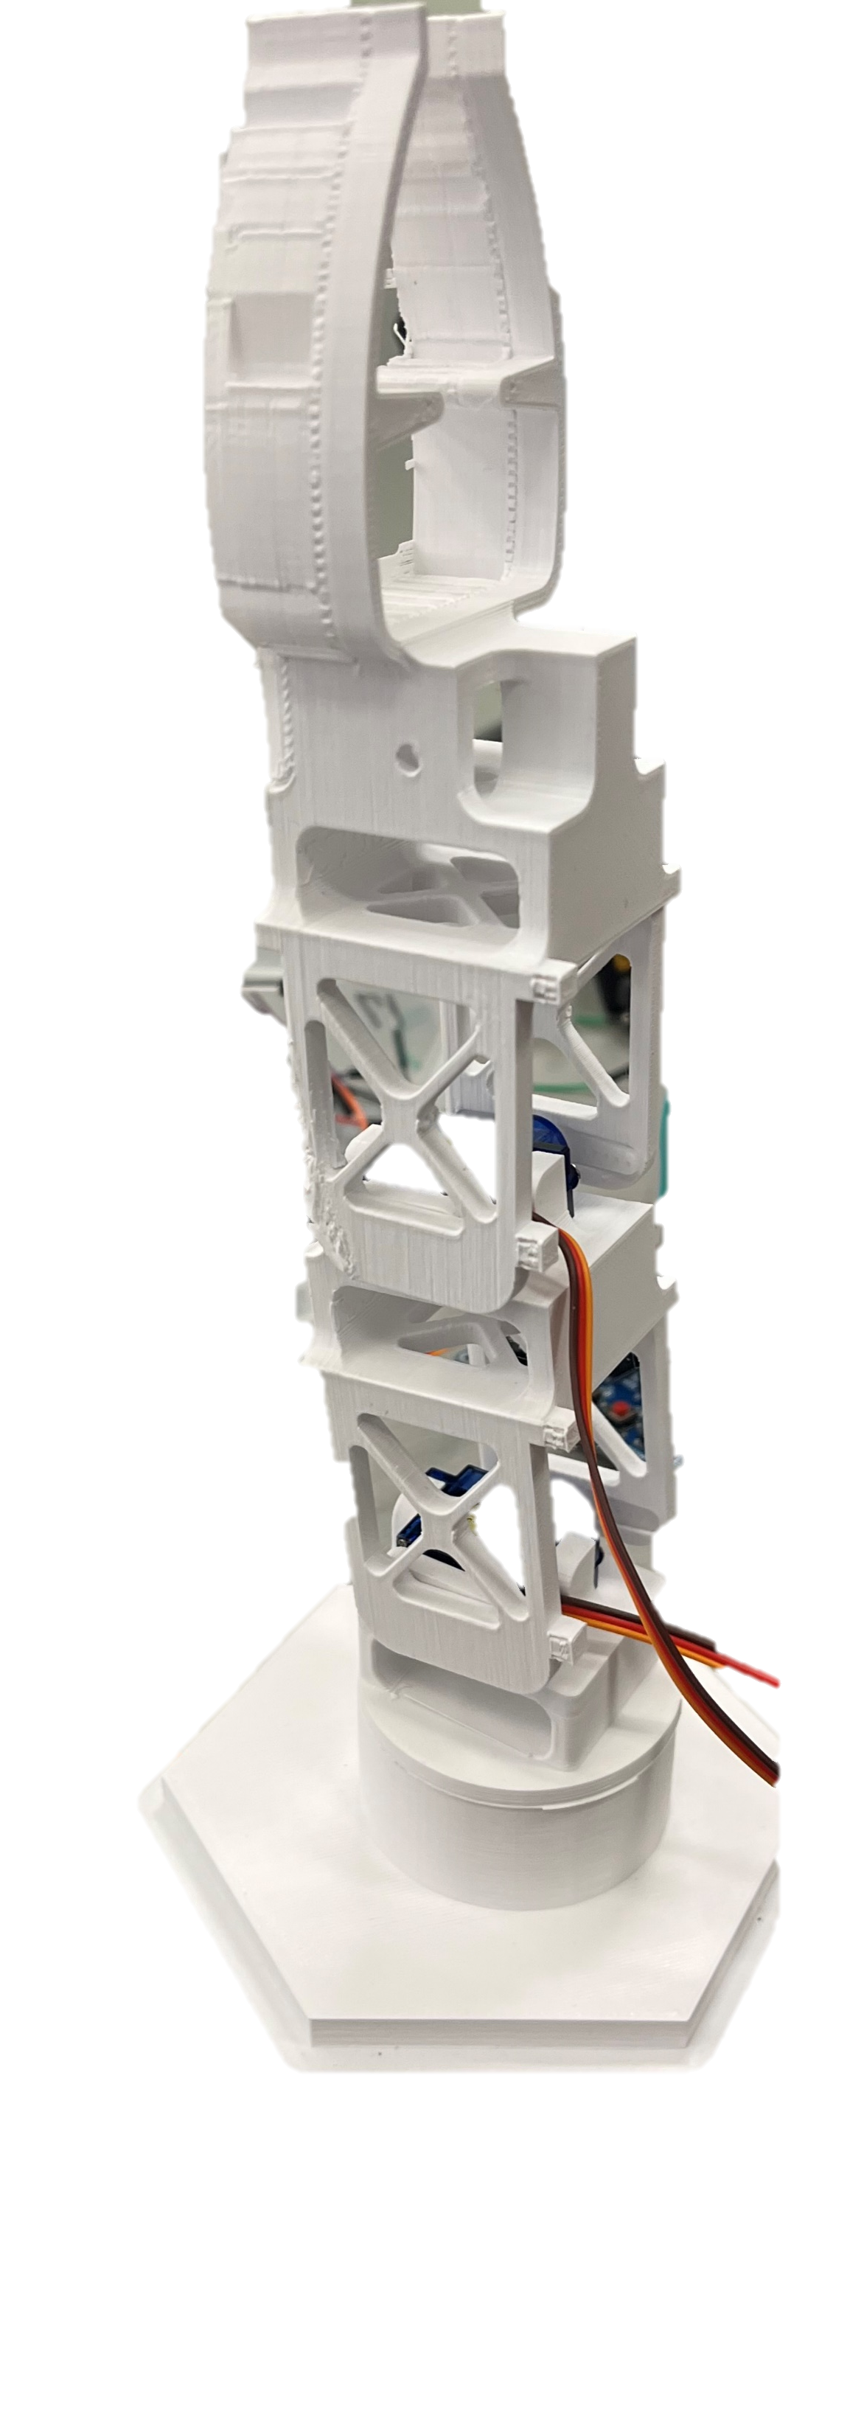
3D-prints and Initial assembly
Used 3D printed frame to construct robot arm.
Printed parts separate, assembled by removing
print supports and putting in servos.
These are the parts to be moved and do work

Slide 5
Initial look at the arm and coding

